Slide 1
Project
Feature Extraction and Price Prediction for Mobile Phones
In this project, I have worked with a dataset that contains detailed information about various mobile phones, including their model, color, memory, RAM, battery capacity, rear camera specifications, front camera specifications, presence of AI lens, mobile height, processor, and, most importantly, the price. Your primary goal is to develop a predictive model for mobile phone prices.
Submitted To
NEXTHIKES ITSOLUTIONS
By
SHUBHAM

Slide 2
Data Exploration (EDA)
Load the dataset, inspect its structure, check data types, summary statistics, and identify missing values or anomalies.

Slide 3
Analysis & Visualization:
Analysis: We verify data types to ensure numerical features
(Memory, RAM, Battery_, Mobile Height, Prize) are correctly parsed,
and categorical features (Model, Colour, Processor_, etc.) are
recognized as strings/objects.
Diagram/Visualization: Correlation Heatmap to spot
linear relationships between numerical features and the target (Prize).

Slide 4
Data Preprocessing & Cleaning
Handle missing values, clean string-based camera columns into numeric values, and encode categorical variables.

Slide 5
Feature Extraction & Engineering
Transform raw features into high-performing predictors. By converting camera text attributes into numeric megapixel counts and scaling continuous variables, we ensure machine learning algorithms can effectively compute weights.

Slide 6
Model Building
Split the dataset into training and testing sets, then train a robust regression model (Random Forest Regressor) to predict mobile prices.

Slide 7
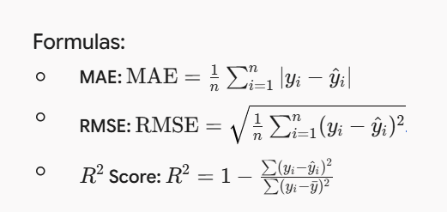
Model Evaluation
Evaluate prediction accuracy using standard regression metrics:
Mean Absolute Error (MAE), Root Mean Squared Error (RMSE), and the Coefficient of Determination.

Slide 8
Feature Importance Analysis
Extract feature importances from the trained Random Forest model to verify which specifications dictate market price the most.

Slide 9
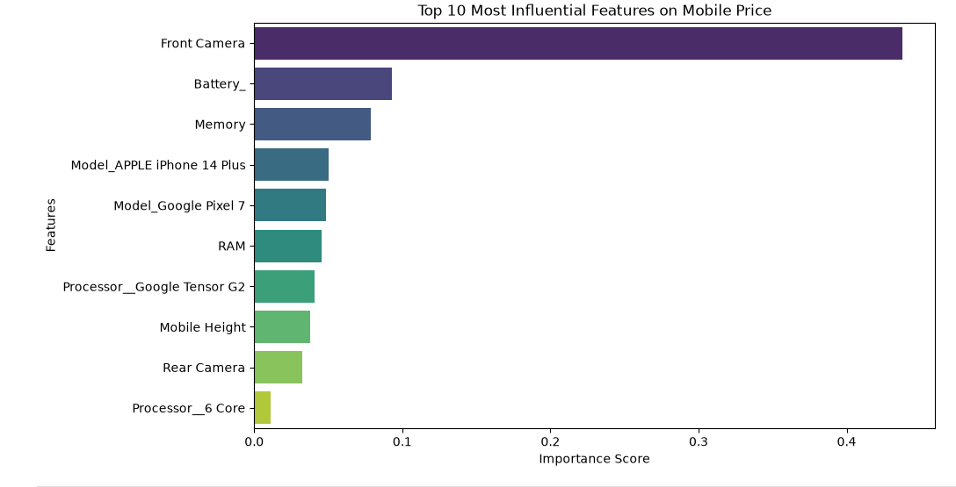
Key Insights & Business Recommendations

Slide 10
THANK YOU NOTE
It is my pleasure to work with you as intern.
I really thankful to you that this plateform give me lot of opportunities to learn with mistakes and correct them.
I highly appreciated my mentor who helped me in every project , and also my mentor assign grades on project ,they clear mention my mistakes, and I work on it.

